Slide 1

Panther Creek High School
Rising 9th Grade
Curriculum Information
Welcome class of 2029 & Families!

Slide 2
Goal of this presentation
To provide information about registration and the course offering information at PCHS for the 2025-2026 school year.
This presentation will be available at the following link: (Student Services)
Registration/Information
Notes:
We need to add the 25-25 planning guide to our website if available.

Slide 3
Questions about scheduling
Point of Contact for questions:
Your assigned 8th grade counselor at your Middle School.
Counselors at PCHS will be assisting rising 10th-12th with registration on campus.
*This presentation will be available on the website the next day.

Slide 4

The nuts and bolts of High School

Slide 5
Sample Schedule
Block 4 x 4 Fall & Spring Semester
1st semester | Period | 2nd semester | Period
Foods I | 1st | English I | 1st
Healthful Living | 2nd | Business Essentials | 2nd
FOM 1 | 3rd | Math IB | 3rd
World History | 4th | Earth Science | 4th

Slide 6
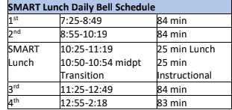
Bell schedule (subject to Change)

Slide 7
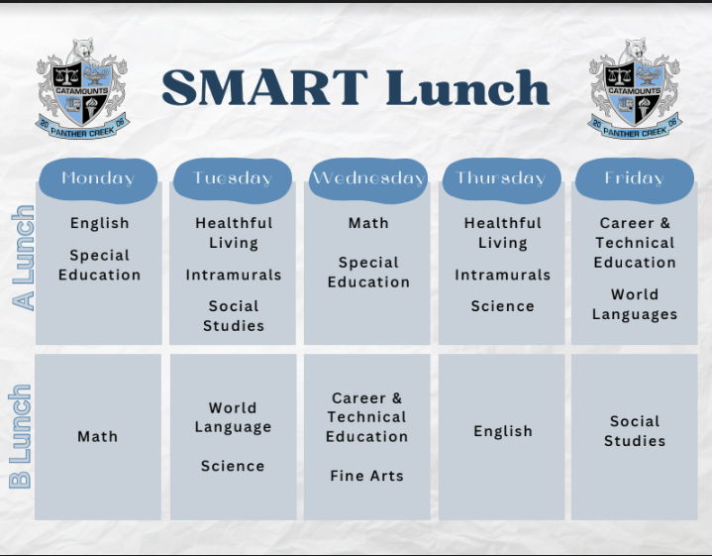
Smart Lunch (Students Maximizing Achievement Relationships & Time)

Slide 8
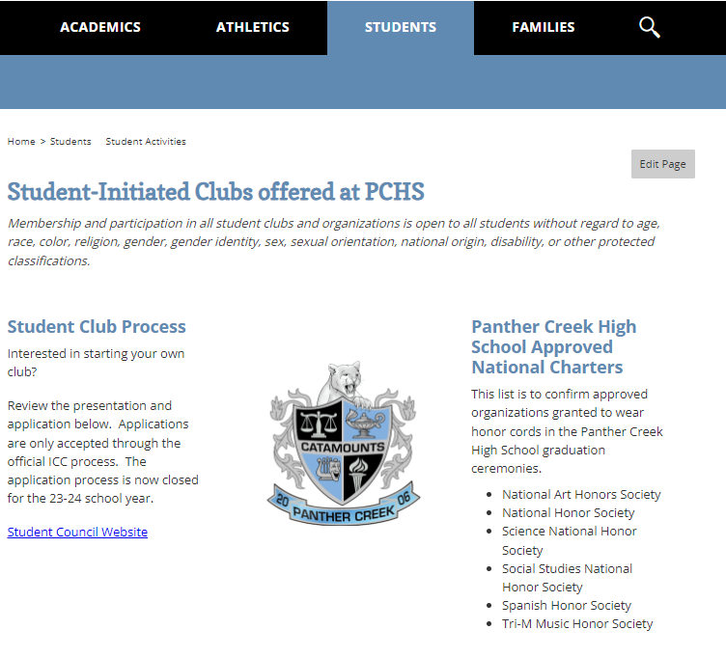
Getting involved at PCHS
** Volunteer hours are great for college applications. However, they are not required for graduation and are not documented by the school.
Student Activities**

Slide 9
Communication at Panther Creek
Parents: Weekly Catamount Messenger to email on file with PowerSchool.
Students:
  Scrolling announcements played all day in classrooms
  Catamount TV: Video news every Monday
  Daily announcements every morning
  Canvas via PCHS Student Announcements

Slide 10
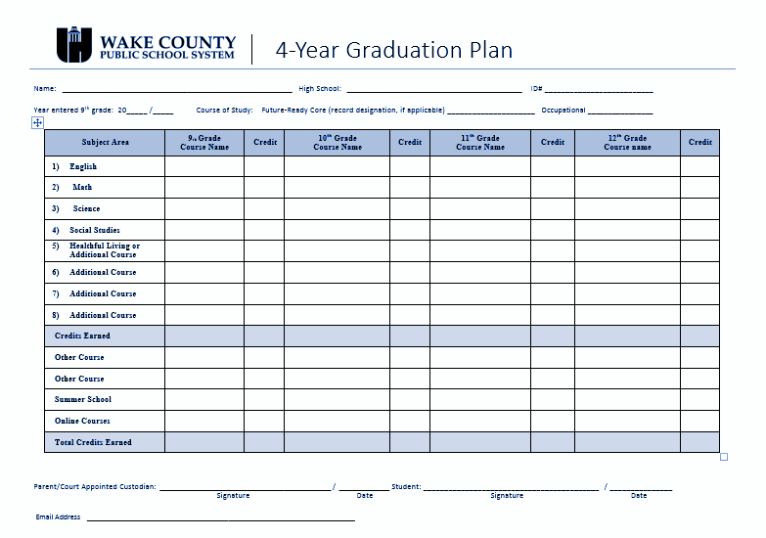
What is a
4-year
plan?
Notes:
UPDATE

Slide 11
Picking Classes for Freshman Year
Core classes:
  1 English
  1 Math
  1 Social Studies
  1 Science
Health and PE (highly recommended to be completed Freshman year)
Elective classes:
  Health and PE
  3 Primary Electives
  5 Alternate Electives*
  Number of electives in 1 year can decrease based on registered core courses
Wake Tech CCP courses are not available to 9th grade students.

Slide 12
Which Core courses are right for my child?
Core Classes should be picked based on:
Teacher Recommendation
Grades in middle school subject classes
Work Habits
EOG Scores
Interests
**Levels: Academic, Honors, Advanced Placement**
Teacher Recommendations
Available to be viewed in PowerSchool by Feb. 17th
PowerSchool
  Course Registration
    Click on subject
      Recommended course will be at top of list
Talk with the teacher if you have questions
Notes:
We need a updated date on this: Available to be viewed in PowerSchool by Feb. 17th

Slide 13
HS Core Courses

Slide 14
HS English
Data Indicators | 9th Grade Course(s)
A or B course grade in 8th Grade English Language Arts OR Level 4 or 5 on previous ELA EOG tests | English I Honors (Semester)
C course grade in 8th Grade English Language Arts; Level 3 on previous ELA EOG tests | English I *Highly recommend that student shows desire and ability to engage in more rigorous coursework
D or F course grade 7th and 8th Grade English Language Arts; Not proficient on previous ELA EOG tests | English I Academic
Options:
-English I
-Honors English I
Notes:
What are we saying about this course: Young Adult Literature & English I Academic

Slide 15
HS Social Studies
Data Indicators | 9th Grade Course(s)
A or B course grade in 8th grade Social Studies OR Level 4 or 5 on most recent ELA EOG | Honors World History
C course grade in 8th grade Social Studies; Level 3 on most recent ELA EOG | Honors or Academic World History
D or F course grade in 8th grade Social Studies; Not proficient on most recent ELA EOG | Academic World History
Options
World History
World History Honors
AP World History

Slide 16

HS
Math

Slide 17
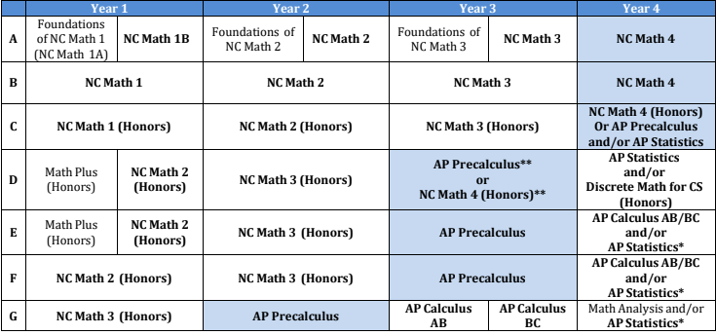

Slide 18
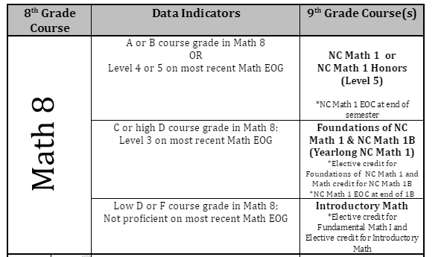
Current Math: Math 8
Options:
Intro to Math
FOM 1A/Math IB
Math 1
Math 1 Honors

Slide 19
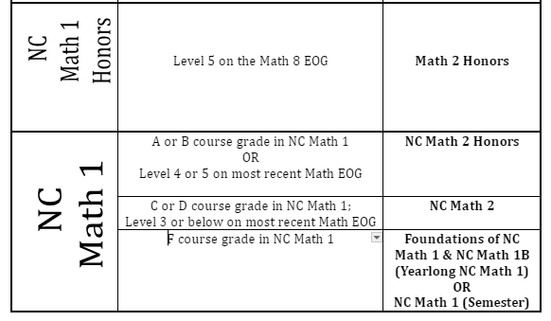
Current Math: Math 1 Honors
Options:
Math 2
Honors Math 2

Slide 20
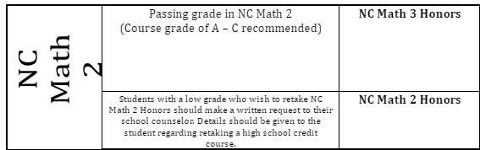
Current Math: Math 2
Options:
Honors Math 3

Slide 21
Current Math: Math 3
8th Grade Course | Data Indicators | 9th Grade Course(s)
Math 3 (for HS credit) | A, B | AP Precalculus or Honors Math 4
 | C, D | Honors/Academic Math 4
 | F | Math 3
Options:
Honors Math 4
Math 4
AP Pre-Calculus

Slide 22
HS Science
Data Indicators | 9th Grade Course(s) | Data Indicators
A or B course grade in 8th Grade Science OR Level 4 or 5 on most recent ELA EOG tests | Honors Earth/Environmental Science or Honors Biology (based on student choice/interest) | A or B course grade in 8th Grade Science OR Level 4 or 5 on most recent ELA EOG tests
C course grade in 8th Grade Science; Level 3 on most recent ELA EOG tests | Honors or Academic Earth/Environmental Science | C course grade in 8th Grade Science; Level 3 on most recent ELA EOG tests
Options:
Earth Science
Honors Earth Science
Honors Biology

Slide 23
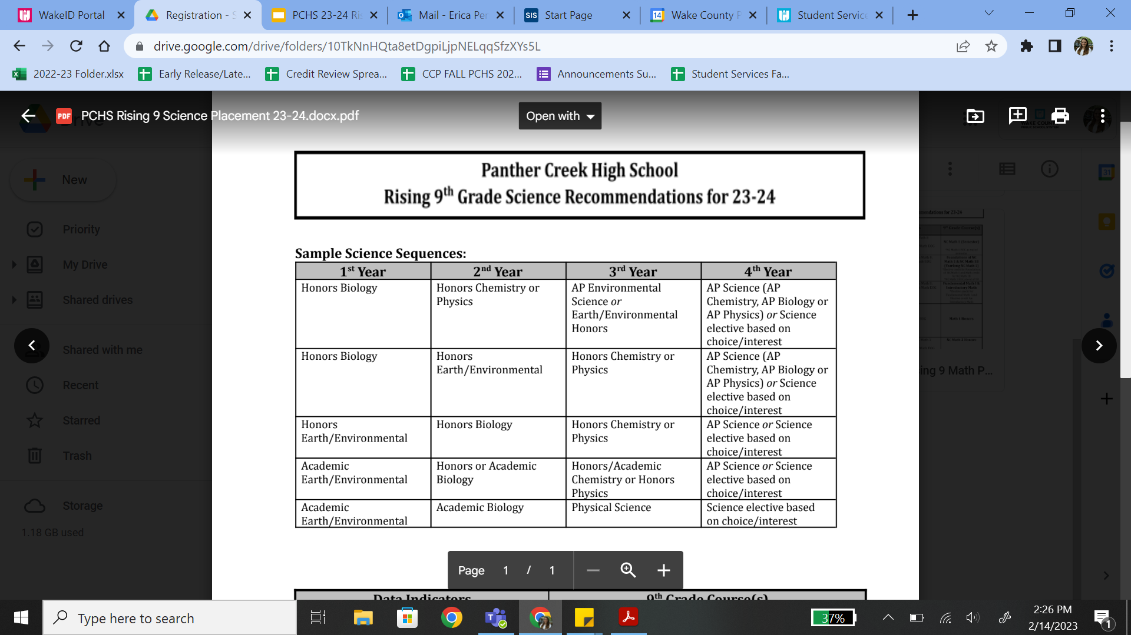
Sample Science Sequencing
Notes:
We have to remember to communicate the prerequisite for sciences courses (EX: math)

Slide 24
Why does Science Depend on Math?
9th Grade Math Course: Foundations of Math and Math IB or Math I
9th | 10th | 11th | 12th
Math 1 | Math 2 | Math 3 | Math 4
Earth Science (Honors or Acad.) | Biology (Honors or Acad.) | Chemistry/Physics/Phy. Science (Academic, Honors, AP)
9th Grade Math Course: Math 2 Honors (or above)
9th | 10th | 11th | 12th
Math 2 | Math 3 | Math 4 | Math Elective
Biology (Honors) | Chemistry/Physics/Phy. Science (Academic, Honors, AP) | Earth Science (Honors or AP)

Slide 25
World Languages
World language credits are NOT REQUIRED for graduation. However, they are HIGHLY RECOMMENDED for entry to a 4-year UNC system college/university.
  Need TWO levels of ONE language
    Spanish 1&2, French 1&2
If you are currently in Spanish 1 (8th grade), continue with language next year.
Why wait?
  Give students time to get used to the block schedule
  Moves FAST and is as difficult as a core class
  Students have more space for electives so they could take both levels in one year (no gap!)
  Can still make it to the AP level if they begin sophomore year
NCVPS Languages (Arabic, Japanese, etc.): NOT available to PCHS students

Slide 26
How to Pick Elective Classes
Considerations:
Transition to 9th grade
Balancing of Schedule
Career Exploration
  Business
  Engineering
  Technology
  Sports Medicine
  Arts
Interests
Prerequisites for other classes
Health and PE:
Need 1 credit to graduate HS
Honors Level
More Information
High School Websites
  Look under Student Services
  Look under 10-12 Registration Sheet
WCPSS High School Planning Guide

Slide 27
IEP: Will transfer to new school and a case manager will be assigned
504: Will transfer to new school and school counselor/ SAP will be case manager
AIG: Will register for Honors and AP courses. There are not any supplemental services.
Suggestions
Be your child’s advocate
Ask questions & seek help
IEP/504/
AIG
How do these transfer?

Slide 28
Registration Process (How Does This Work?)
Review your information received by the middle school with your child.
View teacher recommendations.
Select classes with your child.
Student registers on PowerSchool with the counselor at their Middle School
PCHS Counselors will not be able to meet with you about registration. It all goes through your middle school.
Attend Freshman Orientation in August.

Slide 29
Helpful Links
PCHS Rising 9th Grade Course Offerings
WCPSS 2025-26 Program Planning Guide
PowerSchool Registration Instruction (use this document to view recommendations)
Notes:
NEEDS UPDATE IF ANYTHING CHANGED ON PLANNING GUIDE FOR 25-26

Slide 30

3 Year Grad Option
Mr. Mapp, API
amapp@wcpss.net

Slide 31
North Carolina House Bill 259
A high school student in Wake County Public Schools who is at least 16 years of age in your 3rd year of high school and desires to graduate after 3 years may request to graduate after 3 years of being in high school.
This must be done prior to starting your freshman year.
Students must earn the North Carolina required 22-credits to receive the 3-year diploma.
3-Year graduates may apply to receive a North Carolina scholarship during what would be their 4th year of high school.
Notes:
Decker

Slide 32
3-Year Graduate Application Process
Forms will be available online to print and complete.
Parents/Guardians fill out the 3 Year Application and submit it to their students counselor (submit in person). Forms are due by May 1, 2025. Email completed form to Mr. Mapp.
Students will have to maintain progress towards the NC required 22-credits to remain eligible for the 3-year graduate option.
The school will notify parents/guardians if a student is not meeting the minimum requirements and the student will no longer be eligible for the 3-year graduate option.

Slide 33
3-Year Graduate
Three year graduates may apply to receive a North Carolina scholarship during what would be their fourth year of high school.
This scholarship can only be issued if the student meets the following criteria:
  Enrolled in an eligible postsecondary institution. – A school that is:
    A constituent institution of The University of North Carolina as defined in G.S. 116-2(4).
    A community college as defined in G.S. 115D-2(2).
    A nonprofit postsecondary institution as defined in G.S. 116-280(3).
  Matriculated status. – Being recognized as a student in a defined program of study leading to a degree, diploma, or certificate at an eligible postsecondary institution.

Slide 34
3-Year Early Graduate - Proposed Schedule
9th 1st Sem | 9th 2nd Sem | 10th 1st Sem | 10th 2nd Sem | 11th 1st Sem | 11th 2nd Sem
Math #1 | Math #2 | Civic Lit. or AP Gov & Pol | Amer. History or APUSH | ECON | Eng IV or AP Lit
Eng I | Science #1(Biology or Earth Science) | Eng II | Science #2(Biology or Earth Science) | Eng III or AP Lang | Elective
World History or AP World History | Elective | Math #3 | Comp Science or AP Comp Sci | Math #4 | Elective
Healthful Living | Elective | Elective | Elective | Science #3 (PS, Chem, or Physics | Elective

Slide 35
Key Points
It is our recommendation that students complete all four years of high school to prepare themselves educationally for post-secondary plans.
If a student is approved to be a 3-year graduate, they may have a rigorous schedule that is demanding on time.
Colleges and universities review rigor and course load when considering student applications.
3-Year Graduates will be able to participate in “Graduate Activities” but will not be able to participate in “Senior” only activities due to their non-senior classification.
Students will participate in PCHS graduation.
Pet chat feature

Slide 36
Key Points
Students are not able to participate in any school activities, as a student, after they graduate from high school. Additionally, students cannot return for a 4th year after they have progressed through the 3-year graduate option.
PCHS will recognize early graduates at the school level.
3-Year Early Graduates will be able to attend the PCHS Prom.
3-Year Early Graduates will take the ACT in their junior/final year of high school.
3-Year Graduates will not be able to apply for scholarships designated for seniors.

Slide 37


